Slide 1
KRR Final Presentation
CS Academic Advisor with Companions
Team Members - Albert Guo, Harper Pack, Keith Pallo, Nico Tyjeski

Slide 2
Agenda
Motivation
Related Background Work
Essential Elements of Reasoning and Representation
Output Demo
Questions
Notes:
Keith

Slide 3

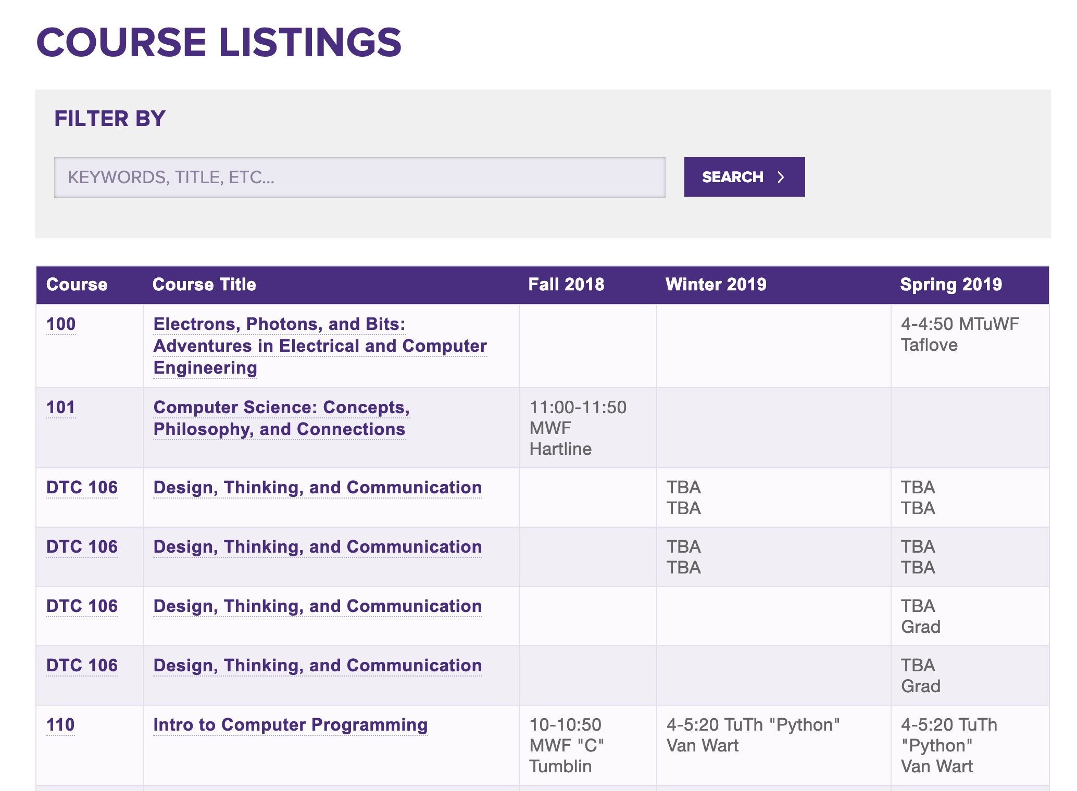



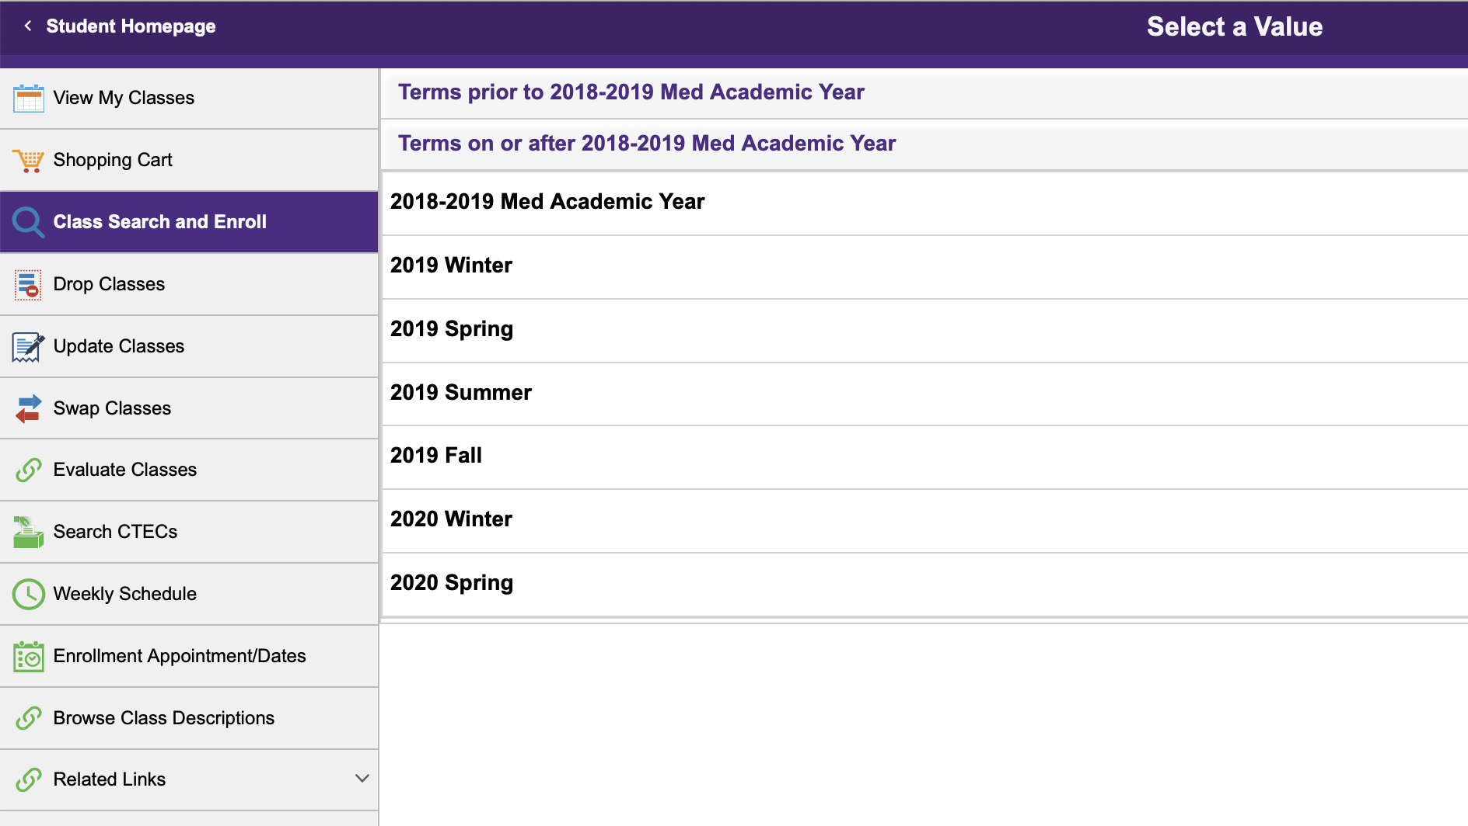


Motivation
Understand Current Needs
Look up available options
Construct Working Schedule
Meet with Academic Advisor
All of this takes time and is extremely inefficient
Notes:
Keith

Slide 4
Desired Attributes for our System
Easy to Use and Always Available
Flexible ( Not an all or nothing use case)
Malleable for Future Functionality
Traditional Model
Revised Model
Resource
Resource
Resource
Resource
Resource
Student
Our System
Resource
Student
Notes:
Keith

Slide 5
Related Background Work
Published Course Manuals
Online Blogs and Articles
Peer Course Reviews
Experience from Other Students
Each of these come with their own major drawbacks, but all are time consuming to utilize
Notes:
Keith

Slide 6
Our System aims to fill the gaps in the current Ecosystem
Resource | Interactive | Available | Authoritative*
Traditional Advisor
Registrar / Department Materials
Peer Guidance
Our KRR System
* Definite answers can be examined
Notes:
Albert

Slide 7
Essential Representation
After first trying to create our own representation, we landed on augmenting the available representation in Companions
Computer
Science-Topic
NUCourse-CS
courseTopic
ArtificialIntelligence
Programming-
Fall2018
Chris
Riesbeck
courseInstructor
courseTimeString
"Monday, Wednesday, and Friday from 11:00 am to 11:50 am"
Notes:
Albert

Slide 8
Essential Reasoning
Is the course available for a given quarter?
I liked a given course. What other courses are similar?
I liked a given Professor. What other courses should I take?
I have these courses in mind for next quarter. Do their times collide?
Is the quarter schedule that I have good for me?
Notes:
Albert

Slide 9
High Level Demo - Core Reasoning

Slide 10
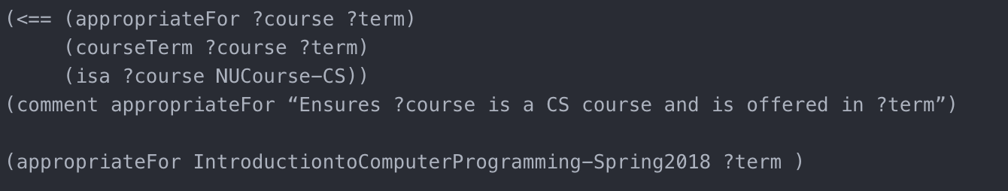
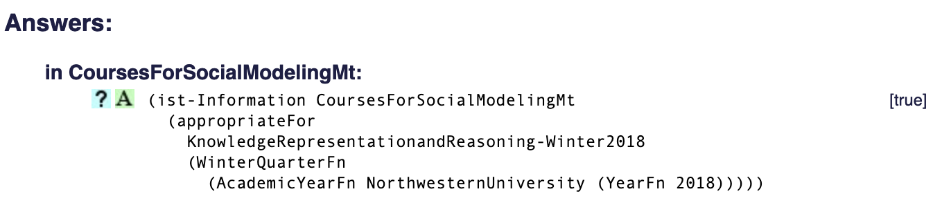
“I’m interested in taking Introduction to Computer Programming in the spring!
Is it going to be offered?”
Notes:
Nico
This is one of the more rudimentary functions that we build off of. So let’s say you’re a freshman, and you’re interested in taking Intro to Computer Programming this spring. The old way of doing it is pulling up the EECS Course page. Instead, now you can boot up Companions and either ask in which quarters a given class is available, or ask explicitly if it’s available next quarter

Slide 11
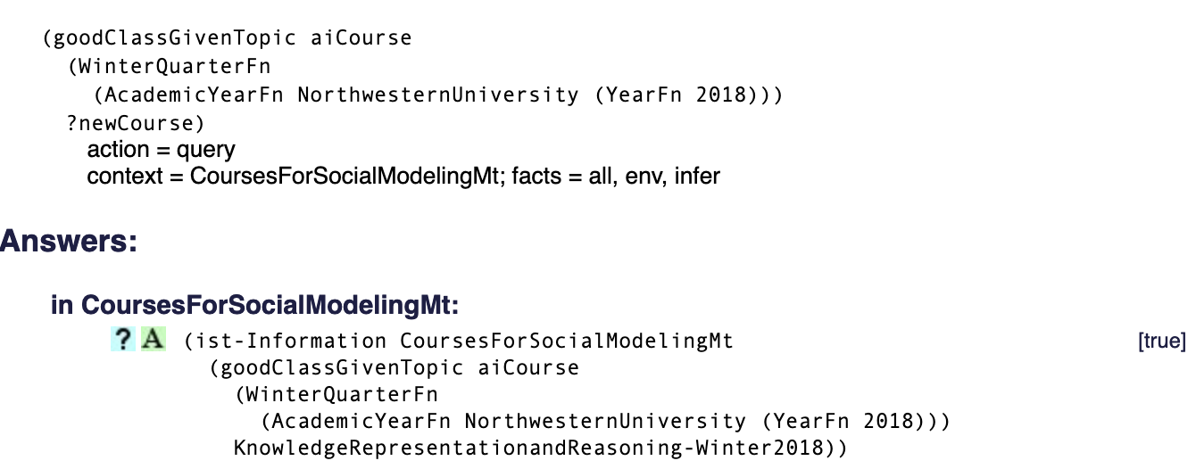
“I’d like to learn about AI this Winter… What are my options?”
Notes:
Now let’s say you’re a sophomore and you’re kind of interested in getting into that whole AI thing. We defined a series of course collections based on the more granular area of CS that they belong to. So if we were to query goodClassGivenTopic with “AI Courses” and a given term, in this case Winter, the rule returns that KRR would be a good class given the topic of AI
Nico

Slide 12
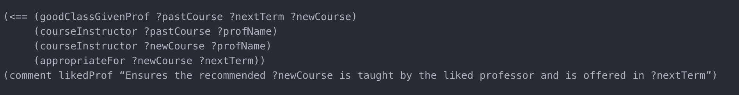
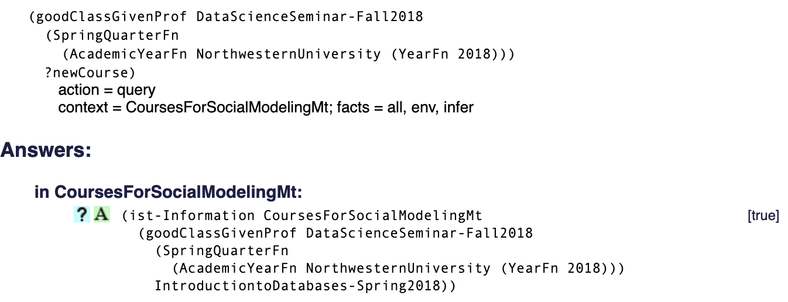
“I enjoyed Prof. Rogers’ Data Science course... Is there anything I can take with her next quarter?”
Notes:
Now let’s say you took Data Science in the fall with Jenny, you enjoyed it, and you’re interested in taking another class with Jenny. You can ask our Companions Advisor “what would be a good class given that I enjoyed the teaching style of Data Science. The rule checks who taught DataScience and looks for courses offered next quarter that are taught by that professor. In this case, it suggests Intro to Databases
Nico

Slide 13
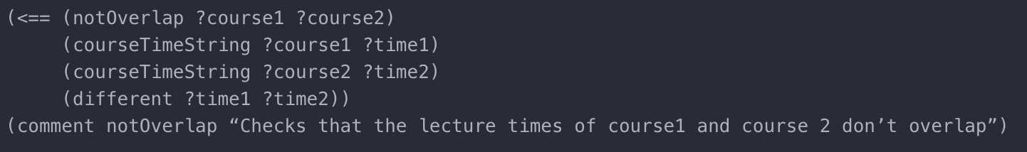
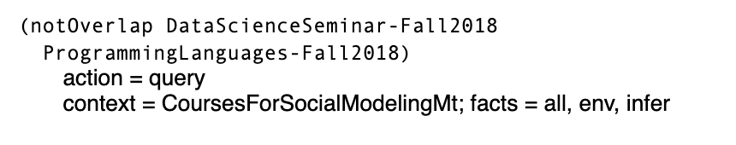

“I’d like to take Machine Learning and Programming Languages next quarter. Do the schedules overlap?”
Notes:
Now you’re a junior. You want to take ML and Programming languages. Do their schedules conflict? Just ask the course advisor, and it’ll check for you and return true if they can both be taken next quarter
Nico

Slide 14
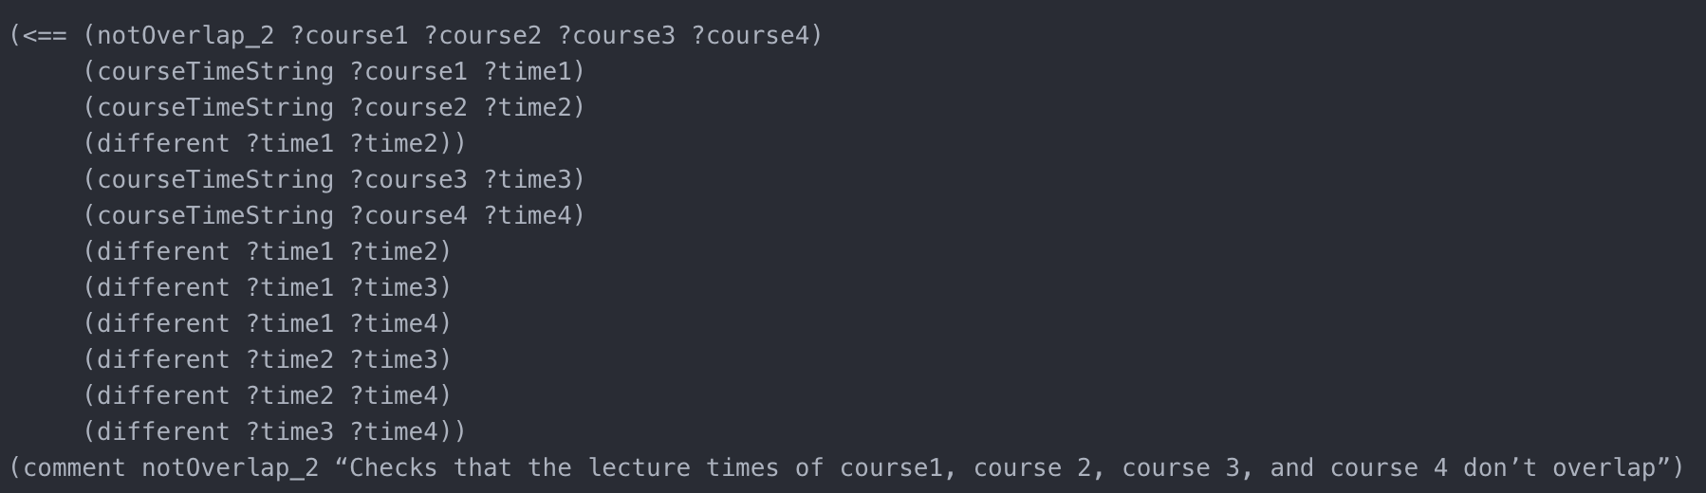
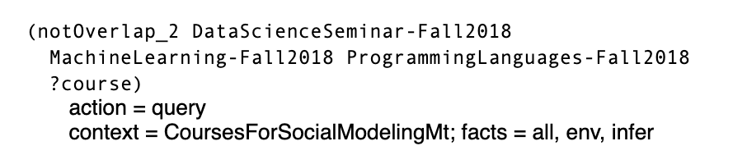
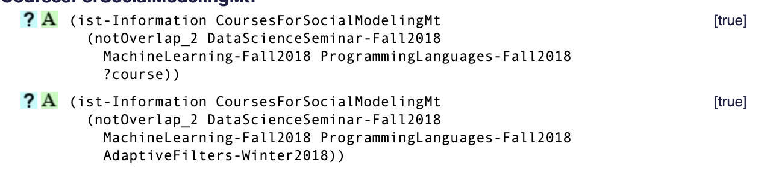
“I’d like to take Data Science, Machine Learning, and Programming Languages next Quarter. What is a fourth class I can take?”
Notes:
Now you’re a senior. You know you want to take Data Science, ML, and Programming Languages next quarter, and don’t really know about your 4th one. What are your options? With this rule, your advisor can return all the logistically feasible fourth classes you could take next quarter! In this case it suggests Computer Architecture I
Nico

Slide 15
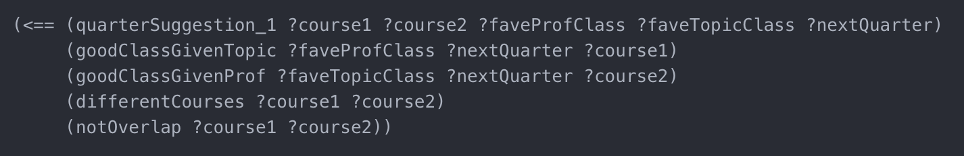
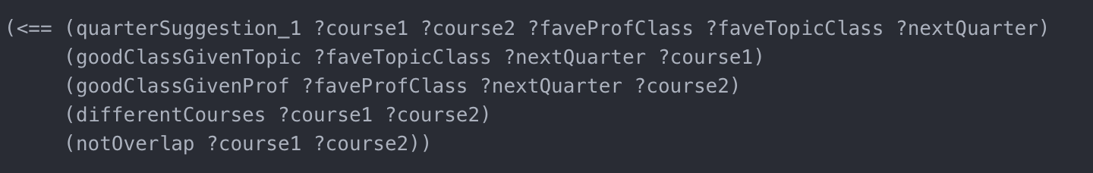
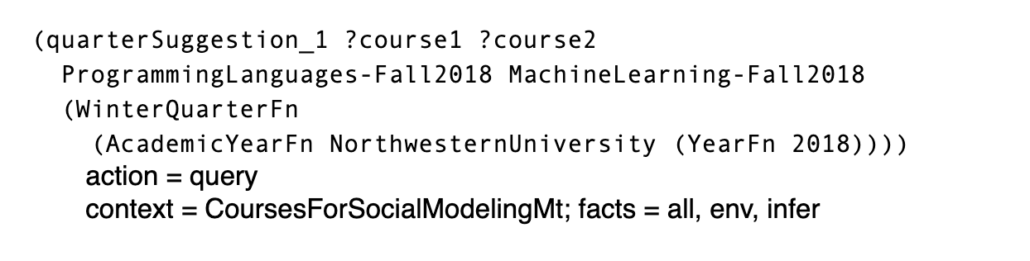

“I enjoyed the teaching style of Machine Learning, and I enjoyed the course material of Programming Languages, and I have two classes to fill...
Given that information, what would you recommend I take?”
Notes:
You decided to stay for your MS! You have 2 slots to fill in your schedule and go to your Companions Advisor for advice. They ask what your favorite class was in terms of teaching style, and you say ML. They ask what your favorite class was in terms of course material, and you say Programming languages. What 2 classes should you take given that information? Well our rule spits out that you should take
(isa ?favTopicClass ?topic)
(goodClassGivenTopic ?topic ?nextQuarter ?course1)
Nico
(genls aiCourse Topic)
(<== (quarterSuggestion_1 ?course1 ?course2 ?faveProfClass ?faveTopicClass ?nextQuarter)
(goodClassGivenProf ?faveProfClass ?nextQuarter ?course1)
(isa ?favTopicClass ?topic)
(goodClassGivenTopic ?topic ?nextQuarter ?course2)
(differentCourses ?course1 ?course2)
(notOverlap ?course1 ?course2))

Slide 16
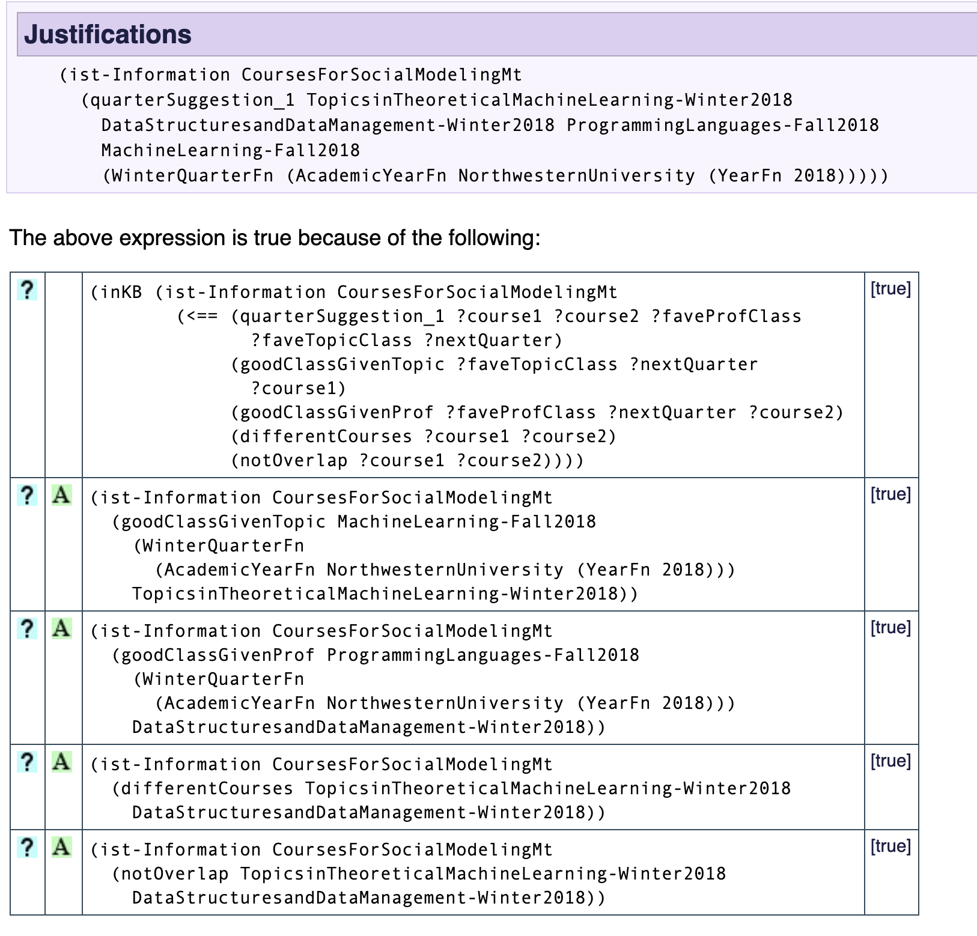
Example Query Tree From Quarter Suggestion
Theoretical ML is chosen because of its Topic similarity to standard ML
Data Structures is chosen because of the Professor similarity to Programming Languages
Courses are ensured to be different
Courses do not overlap
Can easily extend to full quarter - simple version shown here
Notes:
Nico

Slide 17
Enhanced Reasoning

Slide 18
Analogy enables automatic identification of meaningful similarity across different cases...
likedCourse
courseWorkType
courseTopic
assignmentBased
ComputerScience- Topic
course
Introduction
To Artificial
Intelligence
courseSubTopic
courseInstructor
artificialIntelligence
Wilson
courseDifficulty
courseTimeString
hardCourse
“MWF 4:00-4:50”

Slide 19
...allowing users to query using objects rather than criteria
likedCourse
likedCourse ?
likedCourse ?
courseWorkType
courseWorkType
courseWorkType
courseTopic
courseTopic
courseTopic
assignmentBased
course
assignmentBased
assignmentBased
CS- Topic
course
CS- Topic
course
CS- Topic
Intro to AI
courseInstructor
KRR
AI Tools for Thinking
courseSubTopic
courseSubTopic
courseInstructor
courseInstructor
courseSubTopic
aiCourse
Wilson
aiCourse
Wilson
pedagogy Course
Wilensky
courseDifficulty
courseTimeString
courseDifficulty
courseTimeString
courseDifficulty
courseTimeString
hard Course
“MWF 4:00-4:50”
hard Course
“T-Th 2:00-3:20”
easy Course
“MWF 4:00-4:50”

Slide 20




Analogy expands the reasoning capabilities of our system
Analogy-Enabled Capabilities
Better course recommendations
Assisted preference discovery
Counterfactual reasoning
Ongoing user learning

Slide 21
Appendix

Slide 22
Analogy - Code for Reference
(in-microtheory AnalogyTestMt)
(CaseLibraryFn Analogy1Mt Case)
(CaseLibraryFn Analogy2Mt Case)
(in-microtheory CoursesForSocialModelingMt)
(CaseLibraryFn AnalogyTestMt CaseLibrary)
(CaseLibraryFn AnalogyTargetMt Case)
reminding relation

